Slide 1
W4111 – Introduction to Databases Section 002, Fall 2023 Lecture 12: Module IV
© Donald F. Ferguson, 2023

Slide 2

Contents
2 | COMS W4111_002_2023_3: Lecture_12_Module_IV © Donald F. Ferguson, 2023

Slide 3
Relational Database Design Normalization
3 | COMS W4111_002_2023_3: Lecture_12_Module_IV © Donald F. Ferguson, 2023

Slide 4
Overview of Normalization

Slide 5
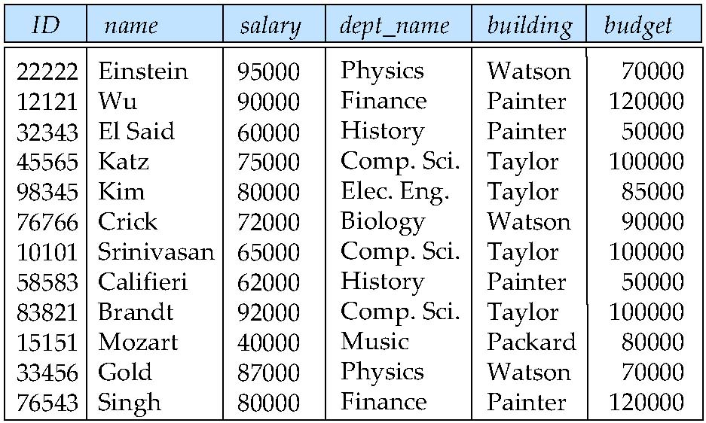
Features of Good Relational Designs
Hypothetically, assume our schema originally had one relation that provided information about faculty and departments.
Suppose we combine instructor and department into in_dep, which represents the natural join on the relations instructor and department
There is repetition of information
Need to use null values (if we add a new department with no instructors)
X → Y
X = (dept_name)
Y = (building, budget)
Pix Physics
Pix Physics
Piy (Watson, 70000)

Slide 6
Decomposition
The only way to avoid the repetition-of-information problem in the in_dep schema is to decompose it into two schemas – instructor and department schemas.
Not all decompositions are good. Suppose we decompose
employee(ID, name, street, city, salary)
into
employee1 (ID, name)
employee2 (name, street, city, salary)
The problem arises when we have two employees with the same name
The next slide shows how we lose information -- we cannot reconstruct the original employee relation -- and so, this is a lossy decomposition.

Slide 7
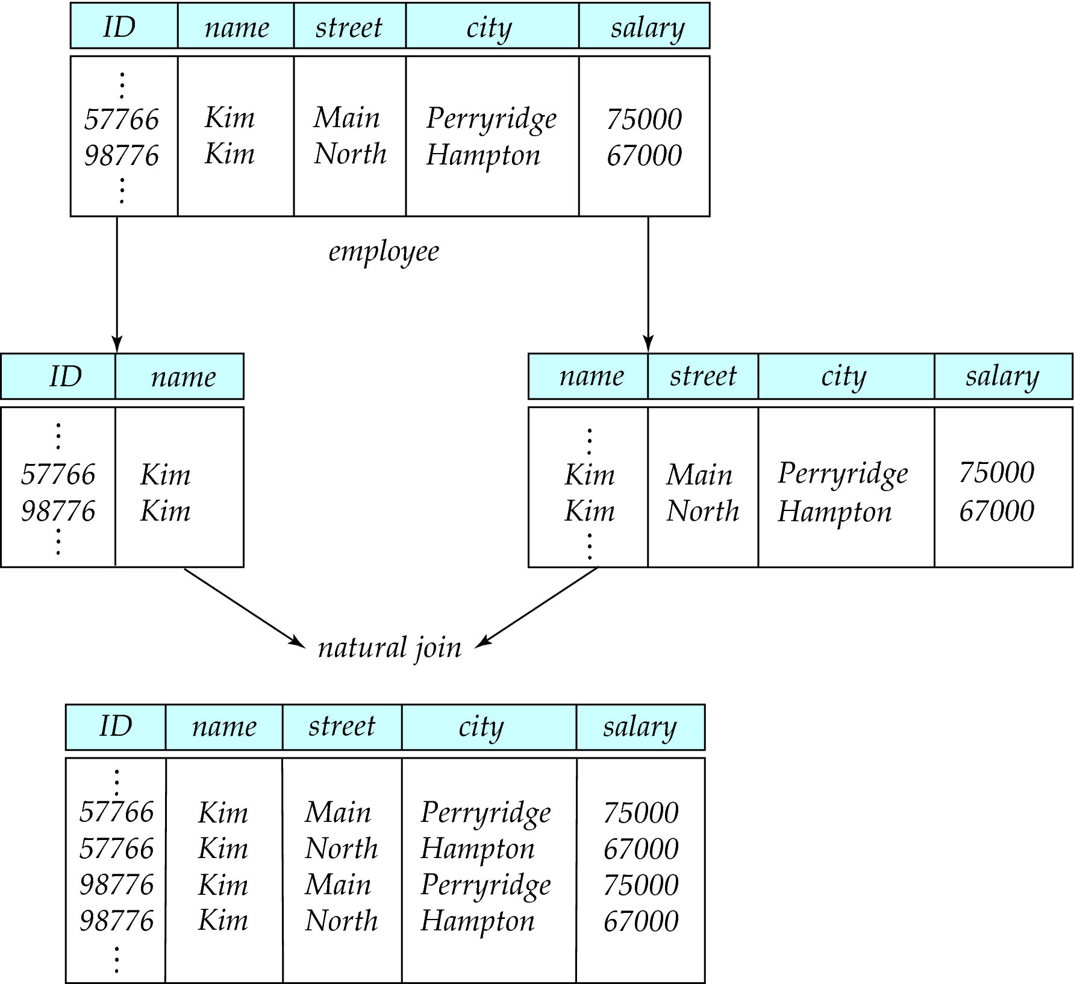
Lossy Decomposition

Slide 8
The Evils of Redundancy
Redundancy is at the root of several problems associated with relational schemas:
redundant storage, insert/delete/update anomalies
Integrity constraints, in particular functional dependencies, can be used to identify schemas with such problems and to suggest refinements.
Main refinement technique: decomposition (replacing ABCD with, say, AB and BCD, or ACD and ABD).
Decomposition should be used judiciously:
Is there reason to decompose a relation?
What problems (if any) does the decomposition cause?
Notes:
14

Slide 9
Example (Contd.)
Wages
Hourly_Emps2
Problems due to R W :
Update anomaly: Can we change W in just the 1st tuple of SNLRWH?
Insertion anomaly: What if we want to insert an employee and don’t know the hourly wage for his rating?
Deletion anomaly: If we delete all employees with rating 5, we lose the information about the wage for rating 5!
Will 2 smaller tables be better?
Notes:
17

Slide 10
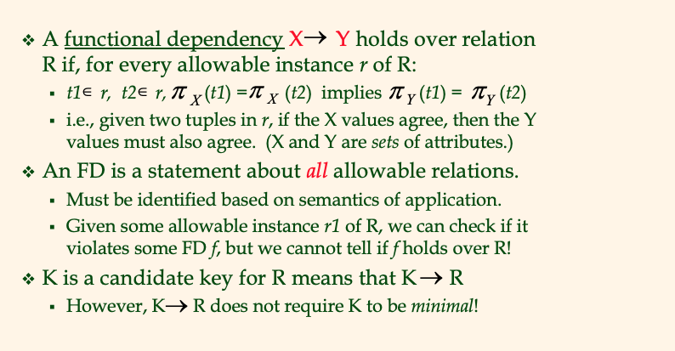
Functional Dependencies (FDs)
Notes:
15

Slide 11
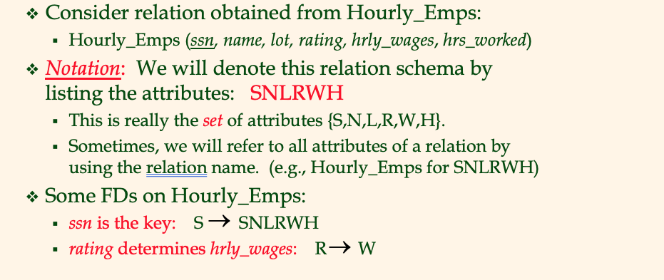
Example: Constraints on Entity Set
Notes:
16

Slide 12
F⁺
(uni, email, last_name, first_name) uni and email are candidate (not NULL, unique)
Uni → email
Email → (last_name, first_name)
➔ Uni → (last_name, first_name)
Person:(uni, email, last_name, first_name), ContactInfo: (email, phone_number, dorm_name)
Uni → email
Email → phone_number, dorm_name
Uni → phone_number, dorm_name

Slide 13
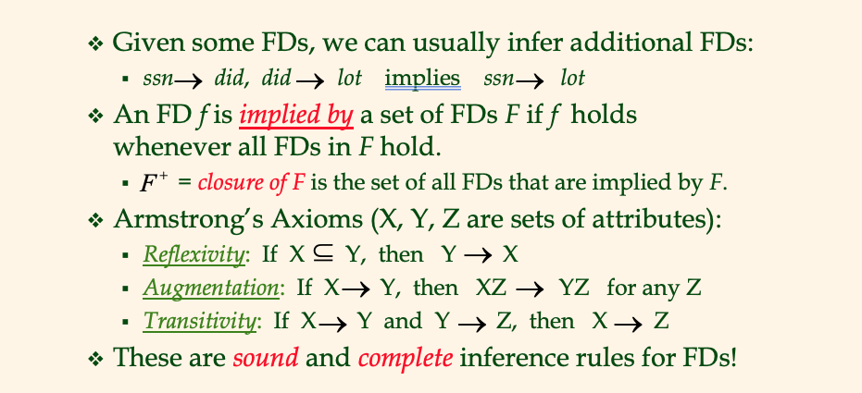
Reasoning About FDs
Notes:
19

Slide 14
Lossless Decomposition
Let R be a relation schema and let R₁ and R₂ form a decomposition of R.
That is R = R₁ U R₂
Note: This notation is confusing. This is a statement about the schema, not about the data in relations.
We say that the decomposition is a lossless decomposition if there is no loss of information by replacing R with the two relation schemas R₁ U R₂
Formally,
∏ _{R1} (r) ∏ _{R2} (r) = r
And, conversely a decomposition is lossy if
r ⊂ ∏ _{R1} (r) ∏ _{R2} (r) = r

Slide 15
Normalization Theory
Decide whether a particular relation R is in “good” form.
In the case that a relation R is not in “good” form, decompose it into set of relations {R₁, R₂, ..., R_{n}} such that
Each relation is in good form
The decomposition is a lossless decomposition
Our theory is based on:
Functional dependencies
Multivalued dependencies

Slide 16
Functional Dependencies
There are usually a variety of constraints (rules) on the data in the real world.
For example, some of the constraints that are expected to hold in a university database are:
Students and instructors are uniquely identified by their ID.
Each student and instructor has only one name.
Each instructor and student is (primarily) associated with only one department.
Each department has only one value for its budget, and only one associated building.

Slide 17
Functional Dependencies (Cont.)
An instance of a relation that satisfies all such real-world constraints is called a legal instance of the relation;
A legal instance of a database is one where all the relation instances are legal instances
Constraints on the set of legal relations.
Require that the value for a certain set of attributes determines uniquely the value for another set of attributes.
A functional dependency is a generalization of the notion of a key.

Slide 18
Functional Dependencies Definition
Let R be a relation schema
α ⊆ R and β ⊆ R
The functional dependency
α → β
holds on R if and only if for any legal relations r(R), whenever any two tuples t₁ and t₂ of r agree on the attributes α, they also agree on the attributes β. That is,
t₁[α] = t₂ [α] ⇒ t₁[β ] = t₂ [β ]
Example: Consider r(A,B ) with the following instance of r.
On this instance, B → A hold; A → B does NOT hold,
4
1 5
3 7

Slide 19
Closure of a Set of Functional Dependencies
Given a set F set of functional dependencies, there are certain other functional dependencies that are logically implied by F.
If A → B and B → C, then we can infer that A → C
etc.
The set of all functional dependencies logically implied by F is the closure of F.
We denote the closure of F by F⁺.

Slide 20
Keys and Functional Dependencies
K is a superkey for relation schema R if and only if K → R
K is a candidate key for R if and only if
K → R, and
for no α ⊂ K, α → R
Functional dependencies allow us to express constraints that cannot be expressed using superkeys. Consider the schema:
in_dep (ID, name, salary, dept_name, building, budget ).
We expect these functional dependencies to hold:
dept_name→ building
ID → building
but would not expect the following to hold:
dept_name → salary
DFF Note:
In the current data: ID → dept_name → building
But
In the schema, dept_name may be NULL..

Slide 21
Use of Functional Dependencies
We use functional dependencies to:
To test relations to see if they are legal under a given set of functional dependencies.
If a relation r is legal under a set F of functional dependencies, we say that r satisfies F.
To specify constraints on the set of legal relations
We say that F holds on R if all legal relations on R satisfy the set of functional dependencies F.
Note: A specific instance of a relation schema may satisfy a functional dependency even if the functional dependency does not hold on all legal instances.
For example, a specific instance of instructor may, by chance, satisfy name → ID.

Slide 22
Normal Forms

Slide 23
Boyce-Codd Normal Form
A relation schema R is in BCNF with respect to a set F of functional dependencies if for all functional dependencies in F⁺ of the form
α → β
where α ⊆ R and β ⊆ R, at least one of the following holds:
α → β is trivial (i.e., β ⊆ α)
α is a superkey for R
DFF Note:
The theoretical treatment is no conveying the practical intent.
If α is α superkey, I can set a primary key/unique constraint on α.
Consider tables with address info in the rows.

Slide 24
Decomposing a Schema into BCNF
Let R be a schema R that is not in BCNF. Let α →β be the FD that causes a violation of BCNF.
We decompose R into:
(α U β )
( R - ( β - α ) )
In our example of in_dep,
α = dept_name
β = building, budget
and in_dep is replaced by
(α U β ) = ( dept_name, building, budget )
( R - ( β - α ) ) = ( ID, name, dept_name, salary )
Note:
This is an example only.
Zip code does not imply city or state in real world.
DFF Note – again this is baffling
R = (id, name_last, name_first, street, city, state, zipcode)
α → β means zipcode → (city, state)
(α U β ) = (zipcode, city, state), which we call Address
R - ( β - α ) ). = R - β + α = (id, name_last, name_first, zipcode), which we call Person
Setting primary key ID in Address and zipcode on Address preserves the dependency and is lossless.

Slide 25
BCNF and Dependency Preservation
It is not always possible to achieve both BCNF and dependency preservation
Consider a schema:
dept_advisor(s_ID, i_ID, department_name)
With function dependencies:
i_ID → dept_name
s_ID, dept_name → i_ID
dept_advisor is not in BCNF
i_ID is not a superkey.
Any decomposition of dept_advisor will not include all the attributes in
s_ID, dept_name → i_ID
Thus, the composition is NOT be dependency preserving

Slide 26
Third Normal Form
A relation schema R is in third normal form (3NF) if for all:
α → β in F⁺
at least one of the following holds:
α → β is trivial (i.e., β ∈ α)
α is a superkey for R
Each attribute A in β – α is contained in a candidate key for R.
(NOTE: each attribute may be in a different candidate key)
If a relation is in BCNF it is in 3NF (since in BCNF one of the first two conditions above must hold).
Third condition is a minimal relaxation of BCNF to ensure dependency preservation (will see why later).

Slide 27
3NF Example
Consider a schema:
dept_advisor(s_ID, i_ID, dept_name)
With function dependencies:
i_ID → dept_name
s_ID, dept_name → i_ID
Two candidate keys = {s_ID, dept_name}, {s_ID, i_ID }
We have seen before that dept_advisor is not in BCNF
R, however, is in 3NF
s_ID, dept_name is a superkey
i_ID → dept_name and i_ID is NOT a superkey, but:
{ dept_name} – {i_ID } = {dept_name } and
dept_name is contained in a candidate key

Slide 28
Comparison of BCNF and 3NF
Advantages to 3NF over BCNF. It is always possible to obtain a 3NF design without sacrificing losslessness or dependency preservation.
Disadvantages to 3NF.
We may have to use null values to represent some of the possible meaningful relationships among data items.
There is the problem of repetition of information.

Slide 29
Goals of Normalization
Let R be a relation scheme with a set F of functional dependencies.
Decide whether a relation scheme R is in “good” form.
In the case that a relation scheme R is not in “good” form, need to decompose it into a set of relation scheme {R₁, R₂, ..., R_{n}} such that:
Each relation scheme is in good form
The decomposition is a lossless decomposition
Preferably, the decomposition should be dependency preserving.

Slide 30
Denormalization for Performance
May want to use non-normalized schema for performance
For example, displaying prereqs along with course_id, and title requires join of course with prereq
Alternative 1: Use denormalized relation containing attributes of course as well as prereq with all above attributes
faster lookup
extra space and extra execution time for updates
extra coding work for programmer and possibility of error in extra code
Alternative 2: use a materialized view defined a course prereq
Benefits and drawbacks same as above, except no extra coding work for programmer and avoids possible errors

Slide 31
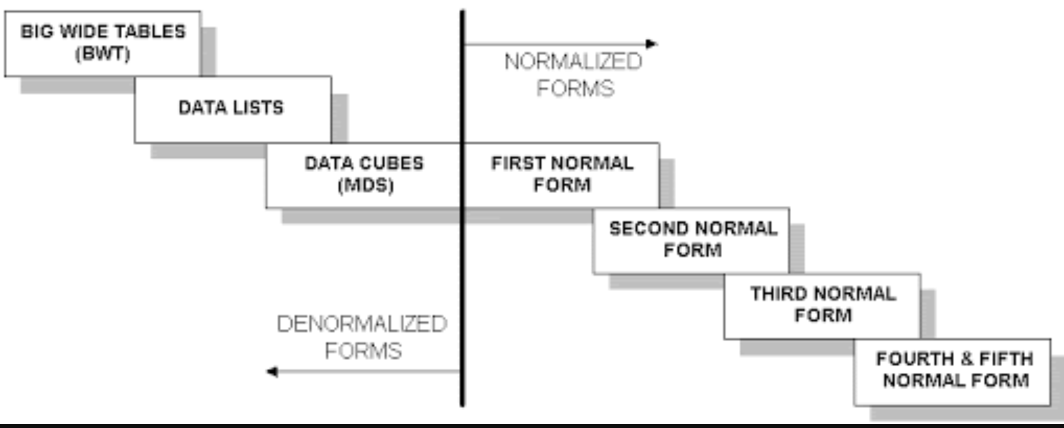
Wide Flat Tables
Good for Integrity
Good for Query
Improve query performance by precomputing and saving:
JOINs
Aggregation
Derived/computed columns
One of the primary strength of the relational model is maintaining “integrity” when applications create, update and delete data. This relies on:
The core capabilities of the relational model, e.g. constraints.
A well-design database (We will cover a formal definition – “normalization” in more detail later.
Data models that are well designed for integrity are very bad for read only analysis queries. We will build and analyze wide flat tables as part of the analysis tasks in HW3, HW4 as projects.

Slide 32
First Normal Form
Domain is atomic if its elements are considered to be indivisible units
Examples of non-atomic domains:
Set of names, composite attributes
Identification numbers like CS 101 that can be broken up into parts
A relational schema R is in first normal form if the domains of all attributes of R are atomic
Non-atomic values complicate storage and encourage redundant (repeated) storage of data
Example: Set of accounts stored with each customer, and set of owners stored with each account
We assume all relations are in first normal form (and revisit this in Chapter 22: Object Based Databases)

Slide 33
First Normal Form (Cont.)
Atomicity is actually a property of how the elements of the domain are used.
Example: Strings would normally be considered indivisible
Suppose that students are given roll numbers which are strings of the form CS0012 or EE1127
If the first two characters are extracted to find the department, the domain of roll numbers is not atomic.
Doing so is a bad idea: leads to encoding of information in application program rather than in the database.

Slide 34
Big Data Business Intelligence
Decision Support
34 | COMS W4111_002_2023_3: Lecture_12_Module_IV © Donald F. Ferguson, 2023

Slide 35

Core Concepts
35 | COMS W4111_002_2023_3: Lecture_12_Module_IV © Donald F. Ferguson, 2023

Slide 36
Chapter 20: Data Analysis
Decision Support Systems
Data Warehousing
Data Mining
Classification
Association Rules
Clustering

Slide 37
Decision Support Systems
Decision-support systems are used to make business decisions, often based on data collected by on-line transaction-processing systems.
Examples of business decisions:
What items to stock?
What insurance premium to change?
To whom to send advertisements?
Examples of data used for making decisions
Retail sales transaction details
Customer profiles (income, age, gender, etc.)

Slide 38
Decision-Support Systems: Overview
Data analysis tasks are simplified by specialized tools and SQL extensions
Example tasks
For each product category and each region, what were the total sales in the last quarter and how do they compare with the same quarter last year
As above, for each product category and each customer category
Statistical analysis packages (e.g., : S++) can be interfaced with databases
Statistical analysis is a large field, but not covered here
Data mining seeks to discover knowledge automatically in the form of statistical rules and patterns from large databases.
A data warehouse archives information gathered from multiple sources, and stores it under a unified schema, at a single site.
Important for large businesses that generate data from multiple divisions, possibly at multiple sites
Data may also be purchased externally

Slide 39
Data Warehousing
Data sources often store only current data, not historical data
Corporate decision making requires a unified view of all organizational data, including historical data
A data warehouse is a repository (archive) of information gathered from multiple sources, stored under a unified schema, at a single site
Greatly simplifies querying, permits study of historical trends
Shifts decision support query load away from transaction processing systems

Slide 40
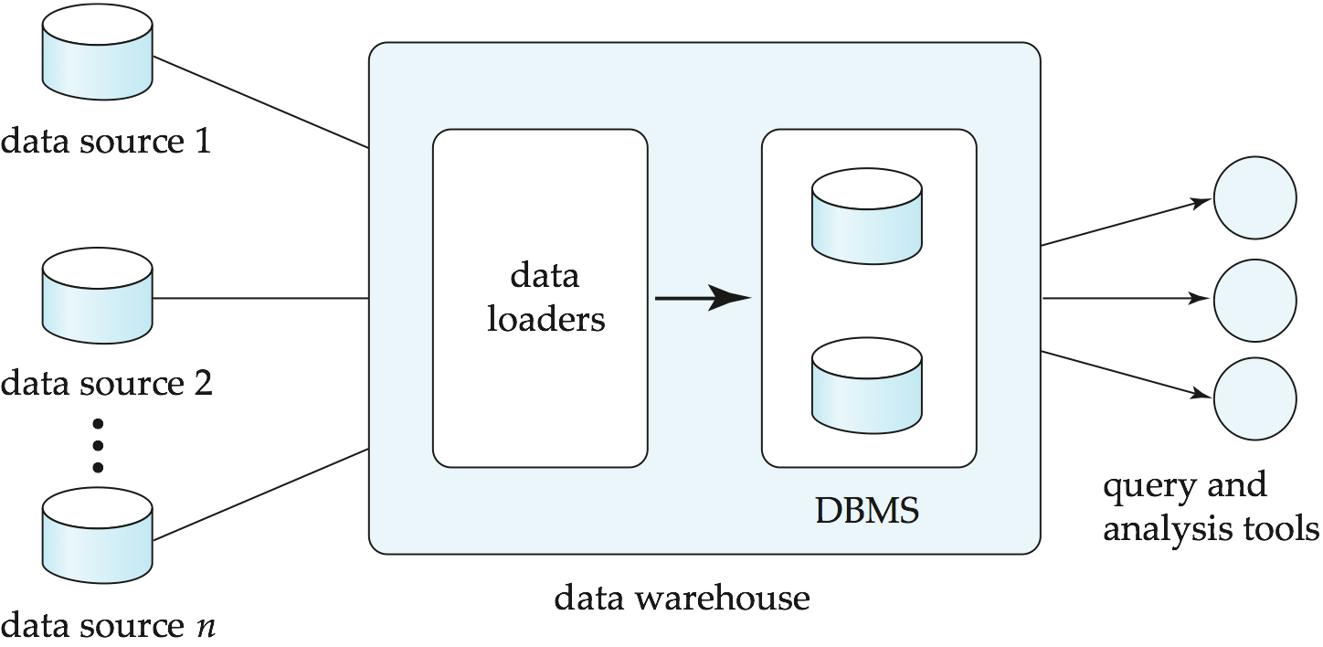
Data Warehousing

Slide 41
Data Warehouse vs Data Lake
https://www.grazitti.com/blog/data-lake-vs-data-warehouse-which-one-should-you-go-for/

Slide 42
Simplistic: Data Warehouse vs Data Lake
https://panoply.io/data-warehouse-guide/data-warehouse-vs-data-lake/

Slide 43
Design Issues
When and how to gather data
Source driven architecture: data sources transmit new information to warehouse, either continuously or periodically (e.g., at night)
Destination driven architecture: warehouse periodically requests new information from data sources
Keeping warehouse exactly synchronized with data sources (e.g., using two-phase commit) is too expensive
Usually OK to have slightly out-of-date data at warehouse
Data/updates are periodically downloaded form online transaction processing (OLTP) systems.
What schema to use
Schema integration

Slide 44
More Warehouse Design Issues
Data cleansing
E.g., correct mistakes in addresses (misspellings, zip code errors)
Merge address lists from different sources and purge duplicates
How to propagate updates
Warehouse schema may be a (materialized) view of schema from data sources
What data to summarize
Raw data may be too large to store on-line
Aggregate values (totals/subtotals) often suffice
Queries on raw data can often be transformed by query optimizer to use aggregate values

Slide 45
Warehouse Schemas
Dimension values are usually encoded using small integers and mapped to full values via dimension tables
Resultant schema is called a star schema
More complicated schema structures
Snowflake schema: multiple levels of dimension tables
Constellation: multiple fact tables

Slide 46
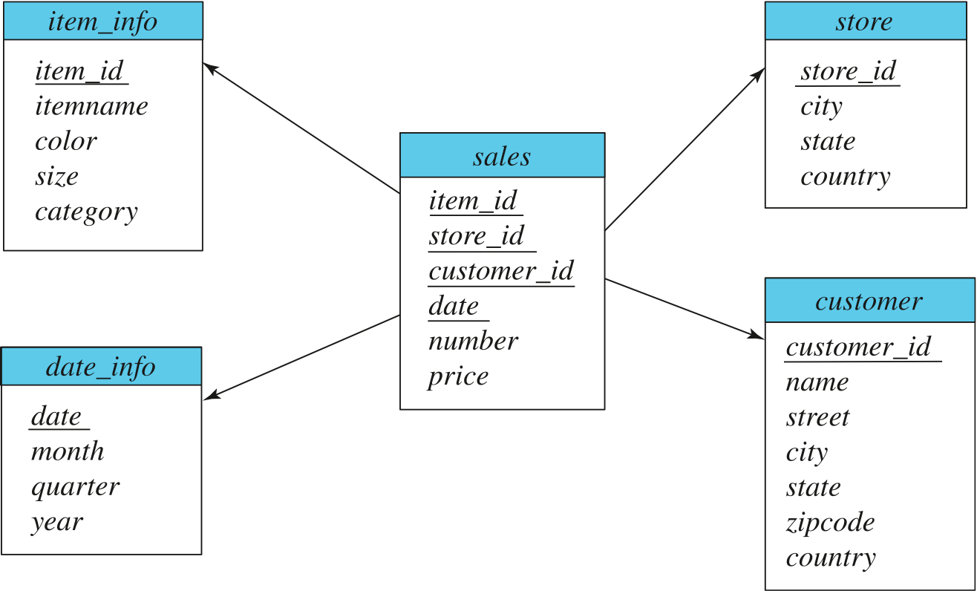
Data Warehouse Schema

Slide 47
Overview (Cont.)
Common steps in data analytics
Gather data from multiple sources into one location
Data warehouses also integrated data into common schema
Data often needs to be extracted from source formats, transformed to common schema, and loaded into the data warehouse
Can be done as ETL (extract-transform-load), or ELT (extract-load-transform)
Generate aggregates and reports summarizing data
Dashboards showing graphical charts/reports
Online analytical processing (OLAP) systems allow interactive querying
Statistical analysis using tools such as R/SAS/SPSS
Including extensions for parallel processing of big data
Build predictive models and use the models for decision making

Slide 48
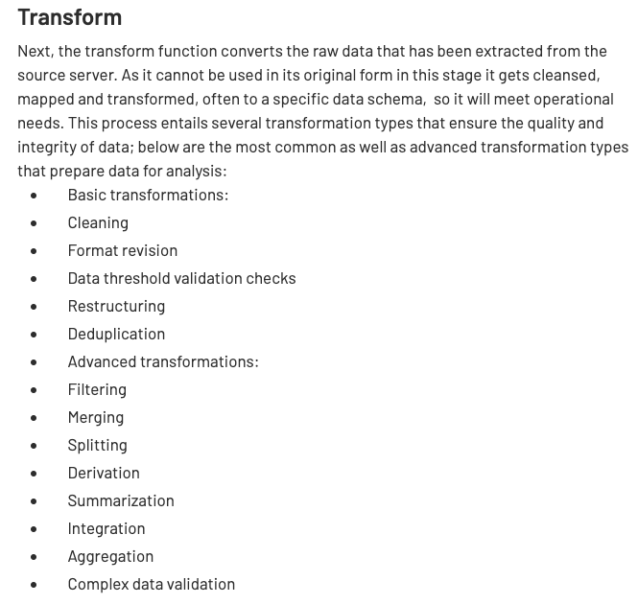
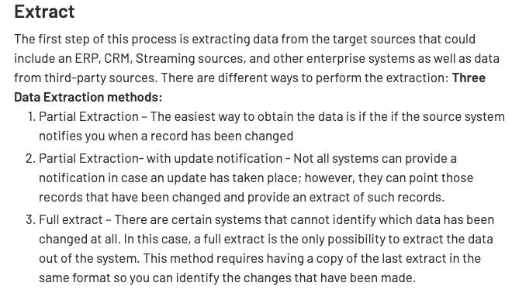
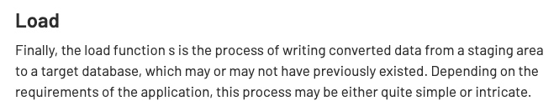
ETL Concepts
https://databricks.com/glossary/extract-transform-load

Slide 49
MapReduce, Spark (and ETL)
49 | COMS W4111_002_2023_3: Lecture_12_Module_IV © Donald F. Ferguson, 2023

Slide 50
MapReduce
MapReduce is a data flow program with relatively simple operators on the data set.
op1
op2
op3
With each operator implemented in parallel on multiple nodes for performance.
What if we want more complex “operators?”

Slide 51
Algebraic Operations
Current generation execution engines
natively support algebraic operations such as joins, aggregation, etc. natively.
Allow users to create their own algebraic operators
Support trees of algebraic operators that can be executed on multiple nodes in parallel
E.g. Apache Tez, Spark
Tex provides low level API; Hive on Tez compiles SQL to Tez
Spark provides more user-friendly API
In the relational model,
The are relations.
A fixed set of operators that produce relations from relations (closed).
Are declarative languages and compute the execution graph/plan.
The Spark/... ... engines:
Enable programmers to develop and add new operators.
Operators convert reliable distributed datasets/data frames to new RDDs/data frames.
Data engineer explicitly defines the execution graph (data flow).

Slide 52
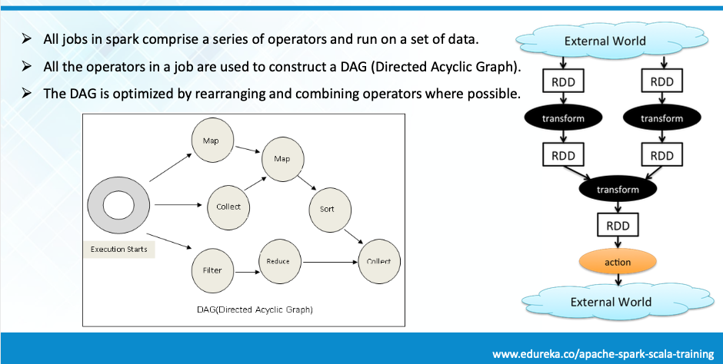
Spark

Slide 53
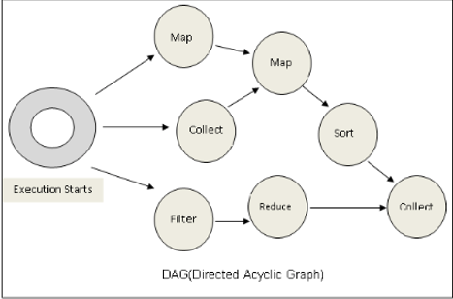
Spark vs SQL
Conceptually similar to query evaluation graph, but ...
You explicitly define the graph.
You can develop your own operators.
You can define levels of parallelism that the infrastructure manages.
SQL is declarative, and the query engine transparently produces the execution plan.

Slide 54
Algebraic Operations in Spark
Resilient Distributed Dataset (RDD) abstraction
Collection of records that can be stored across multiple machines
RDDs can be created by applying algebraic operations on other RDDs
RDDs can be lazily computed when needed
Spark programs can be written in Java/Scala/R
Our examples are in Java
Spark makes use of Java 8 Lambda expressions; the code
s - > Arrays.asList(s.split(" ")).iterator()
defines unnamed function that takes argument s and executes the expression Arrays.asList(s.split(" ")).iterator() on the argument
Lambda functions are particularly convenient as arguments to map, reduce and other functions

Slide 55
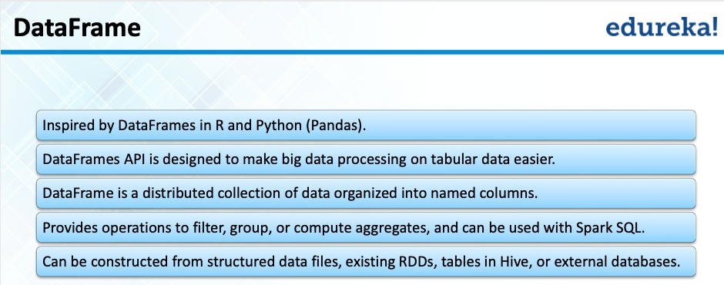
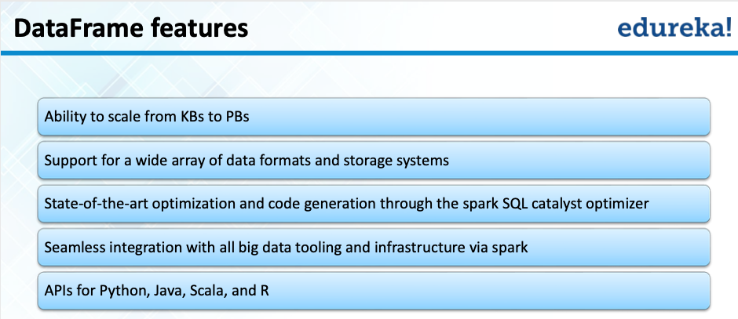
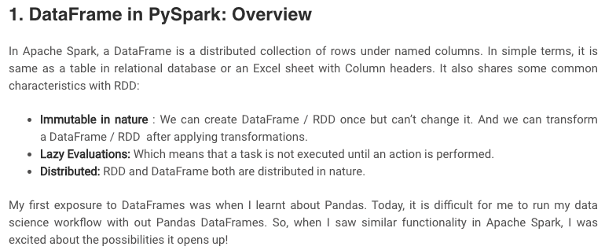
Spark/PySpark
https://www.analyticsvidhya.com/blog/2016/10/spark-dataframe-and-operations/

Slide 57
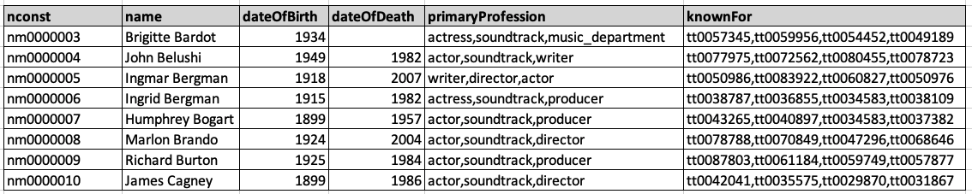
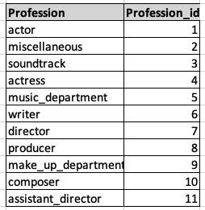
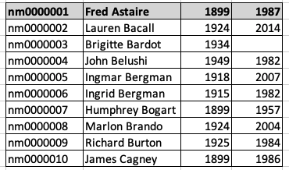
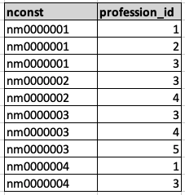
Conceptual Example
Remember that really unpleasant set of queries and stored procedure we had to write for the midterm? You had to convert from ... ...
To

Slide 58
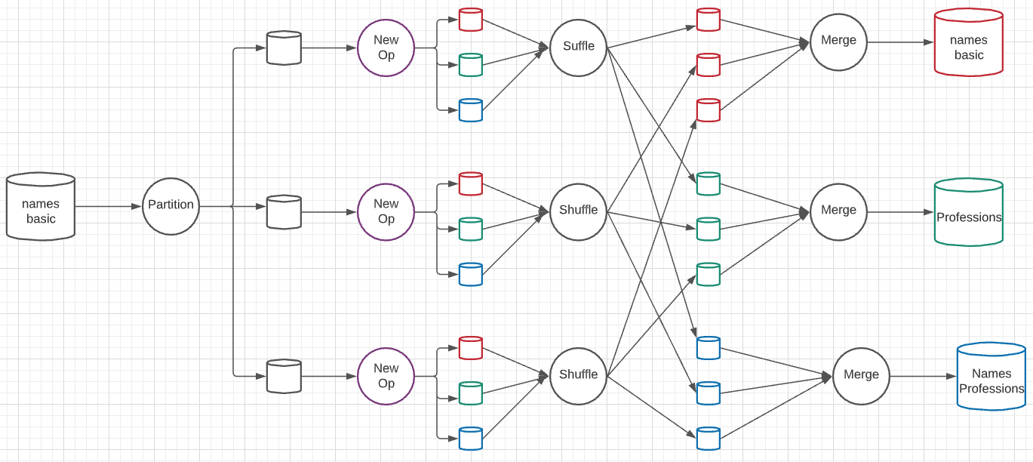
A New Algebraic Operator
Input is a dataset and column ID
Output is three datasets: dataset with column removed, table of distinct column values, associative entity.
Parallelism level is 3 simultaneous services at each stage.

Slide 59
OLAP
59 | COMS W4111_002_2023_3: Lecture_12_Module_IV © Donald F. Ferguson, 2023

Slide 60
Data Analysis and OLAP
Online Analytical Processing (OLAP)
Interactive analysis of data, allowing data to be summarized and viewed in different ways in an online fashion (with negligible delay)
We use the following relation to illustrate OLAP concepts
sales (item_name, color, clothes_size, quantity)
This is a simplified version of the sales fact table joined with the dimension tables, and many attributes removed (and some renamed)

Slide 61
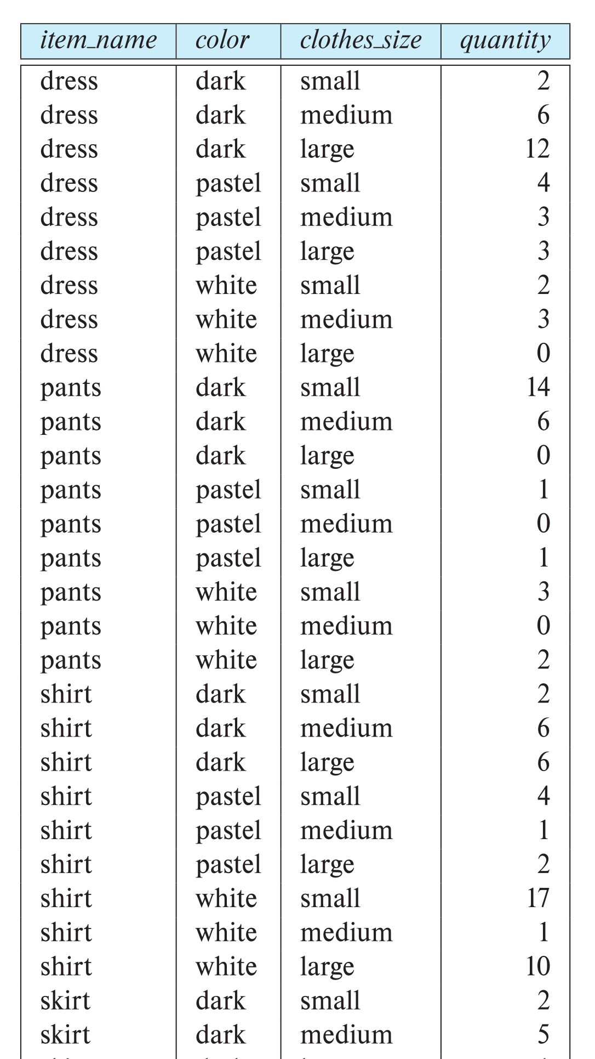
Example sales relation
...
...
...
...
...
...
...
...

Slide 62
Cross Tabulation of sales by item_name and color
The table above is an example of a cross-tabulation (cross-tab), also referred to as a pivot-table.
Values for one of the dimension attributes form the row headers
Values for another dimension attribute form the column headers
Other dimension attributes are listed on top
Values in individual cells are (aggregates of) the values of the dimension attributes that specify the cell.

Slide 63
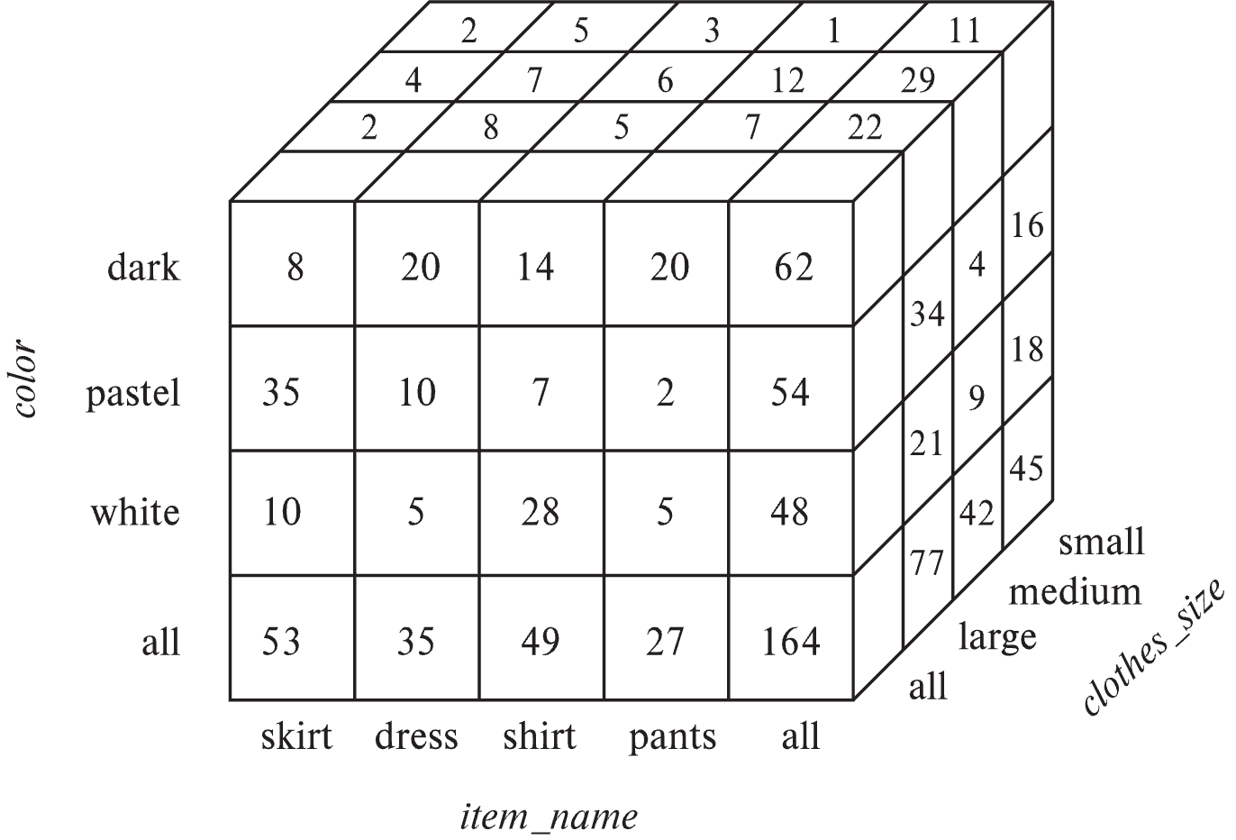
Data Cube
A data cube is a multidimensional generalization of a cross-tab
Can have n dimensions; we show 3 below
Cross-tabs can be used as views on a data cube

Slide 64
Online Analytical Processing Operations
Pivoting: changing the dimensions used in a cross-tab
E.g., moving colors to column names
Slicing: creating a cross-tab for fixed values only
E.g., fixing color to white and size to small
Sometimes called dicing, particularly when values for multiple dimensions are fixed.
Rollup: moving from finer-granularity data to a coarser granularity
E.g., aggregating away an attribute
E.g., moving from aggregates by day to aggregates by month or year
Drill down: The opposite operation - that of moving from coarser-granularity data to finer-granularity data

Slide 65
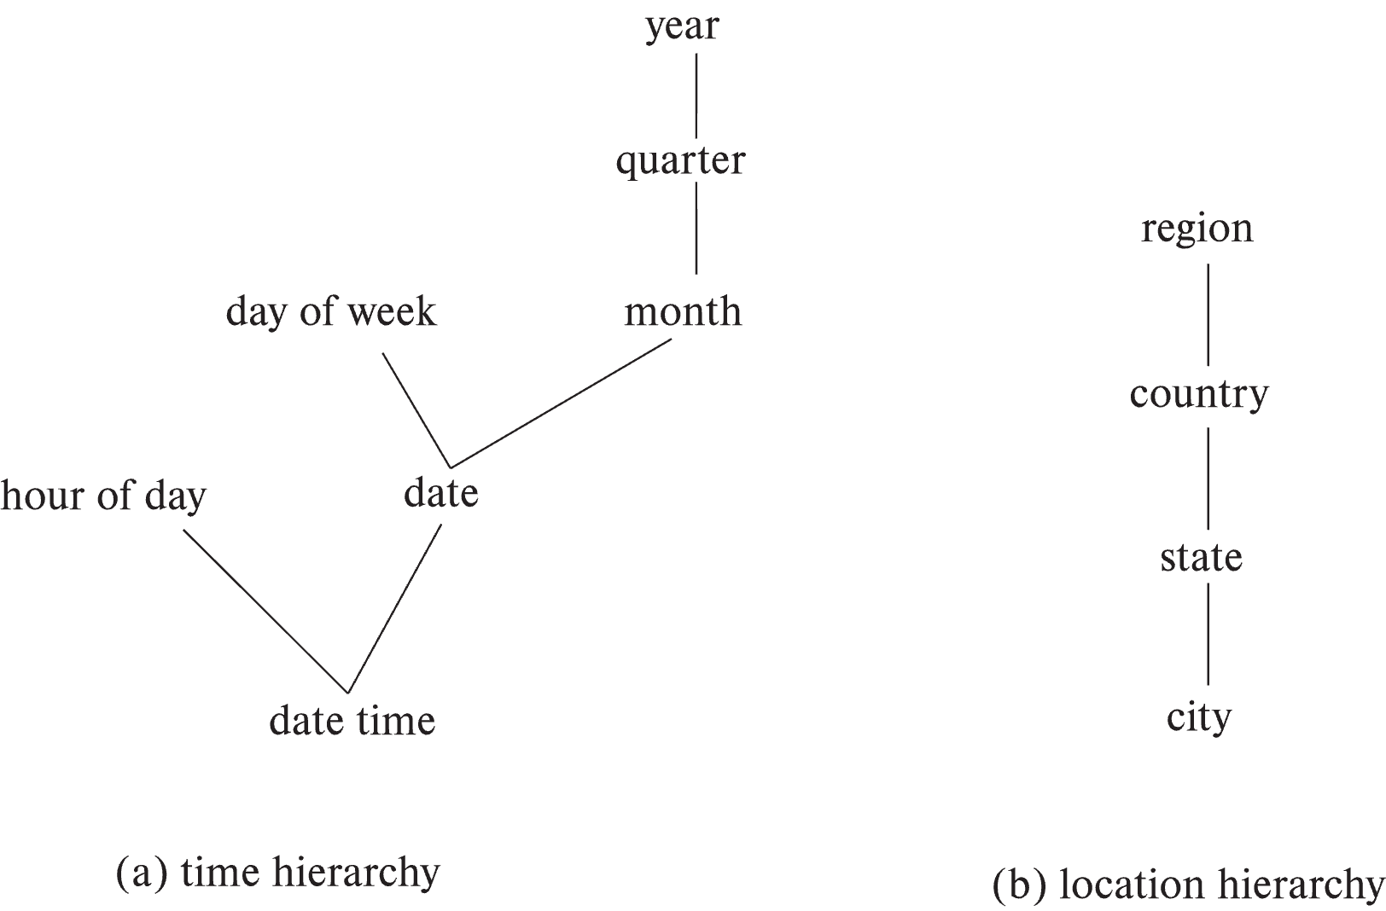
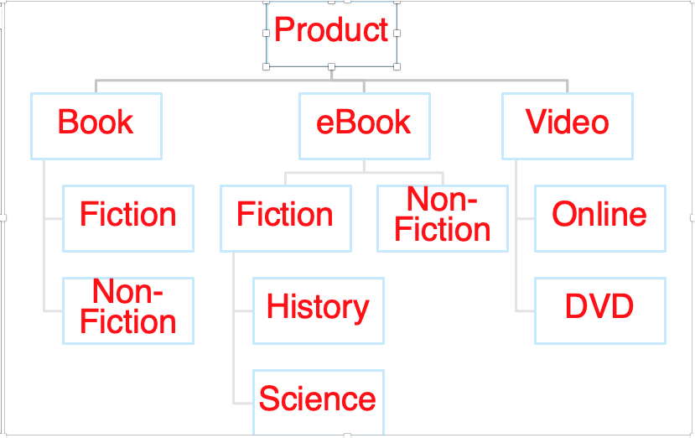
Hierarchies on Dimensions
Hierarchy on dimension attributes: lets dimensions be viewed at different levels of detail
E.g., the dimension datetime can be used to aggregate by hour of day, date, day of week, month, quarter or year
Another dimension could be ... Product category.

Slide 66
Another Dimension Example – Product Categories
Product
Book
eBook
Video
Fiction
Non-Fiction
Non-
Fiction
Fiction
Online
DVD
History
Science

Slide 67
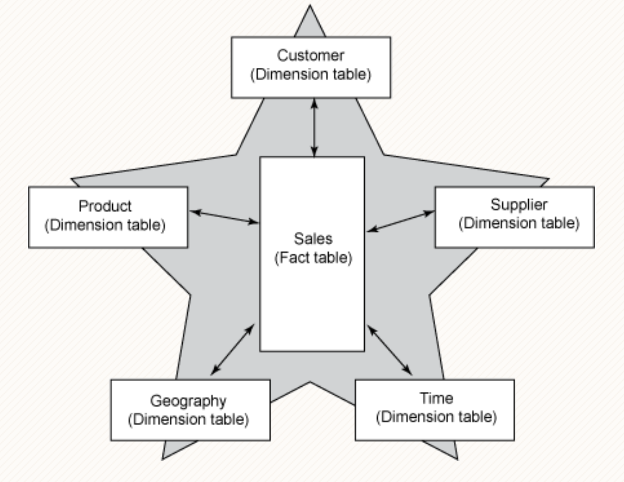
Facts and Dimensions

Slide 68
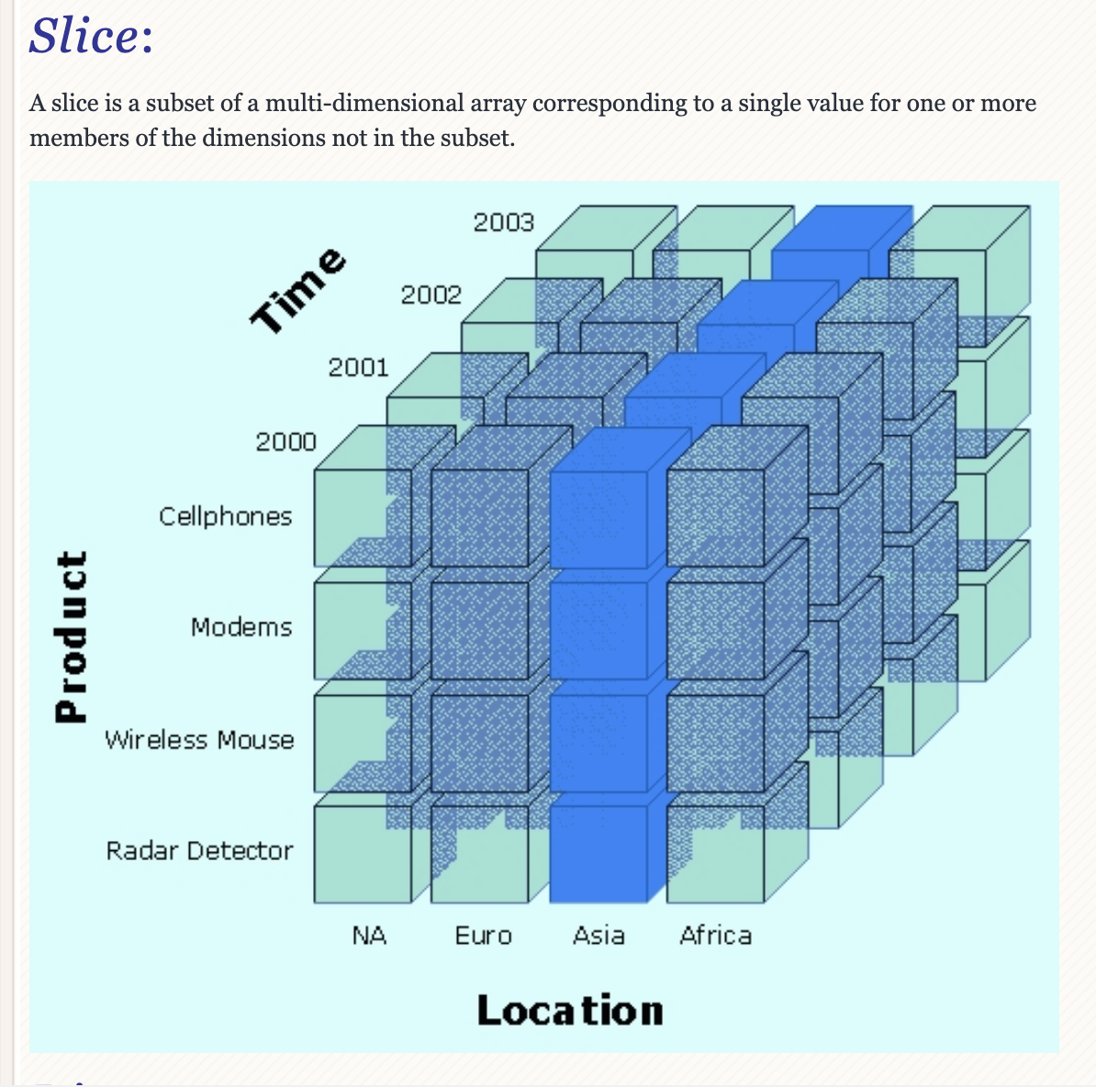
Slice

Slide 69
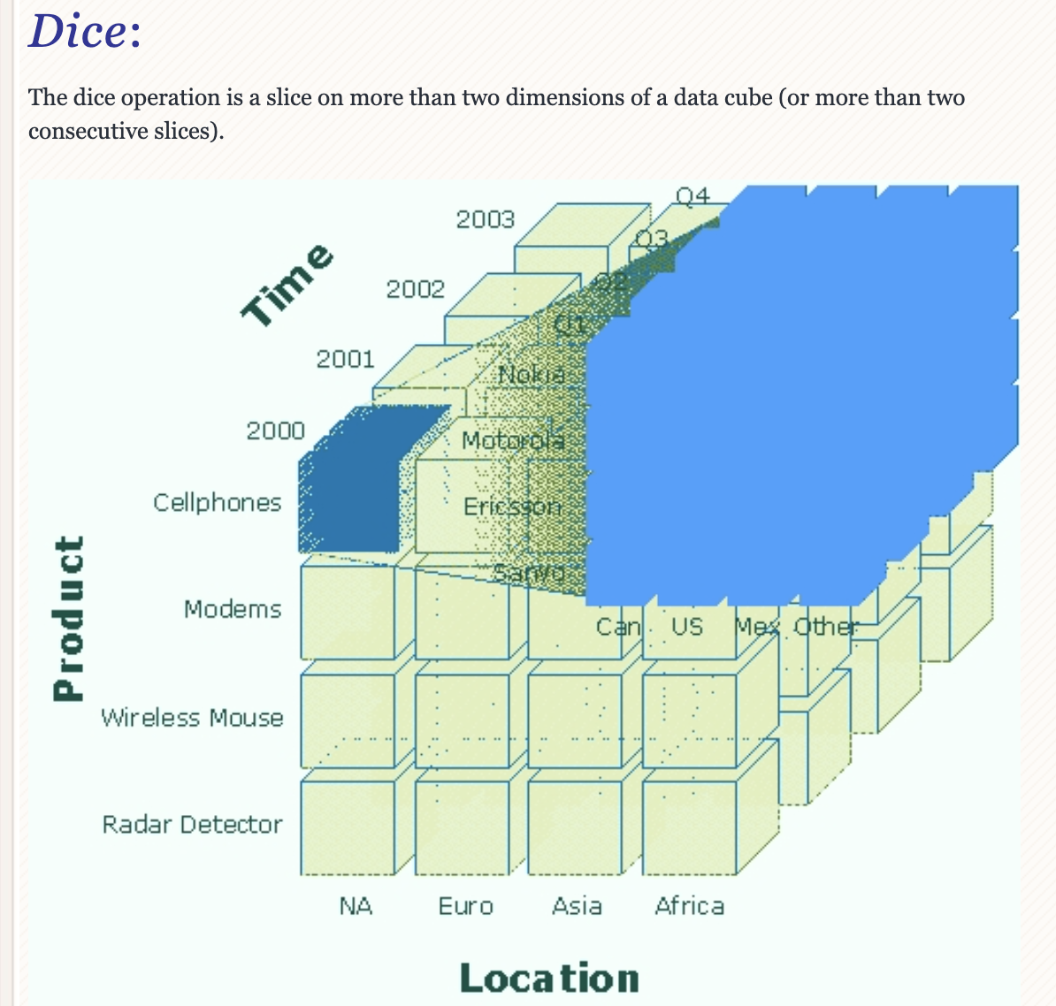
Dice

Slide 70
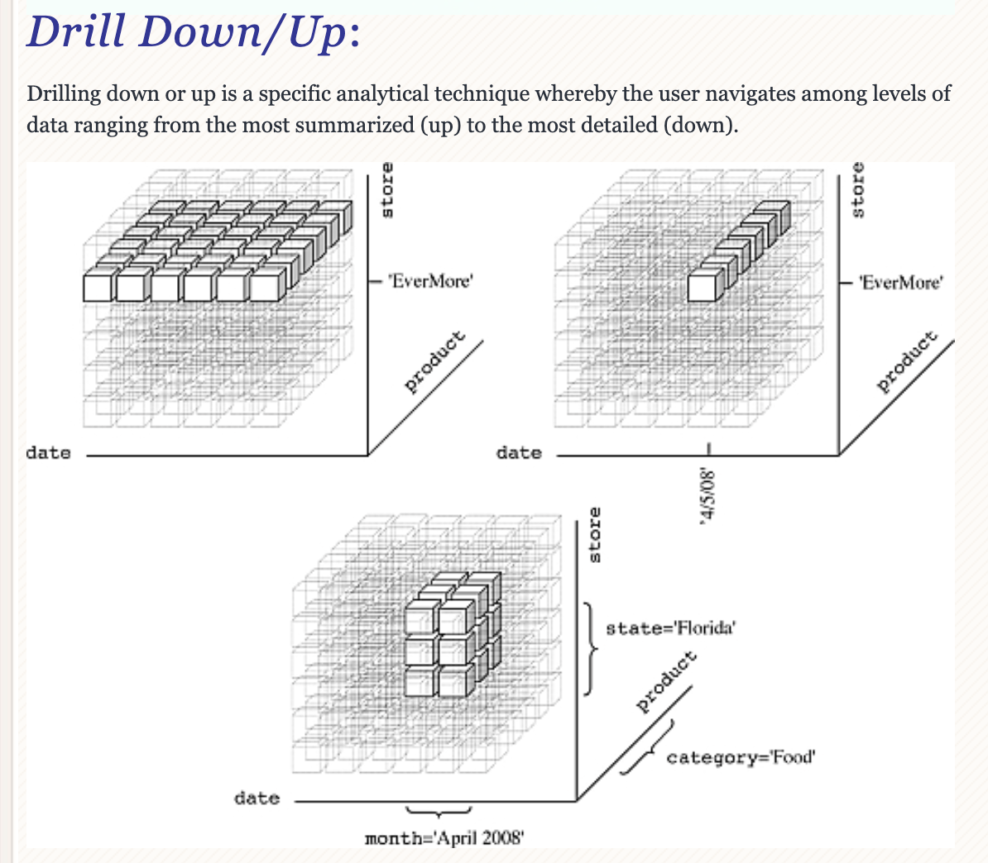
Drilling

Slide 71
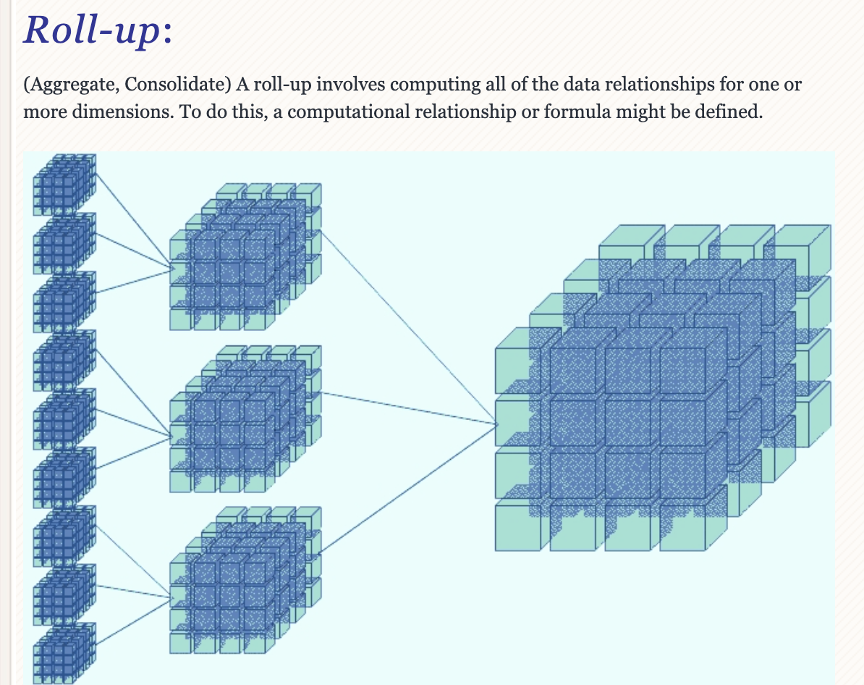
Roll-up

Slide 72
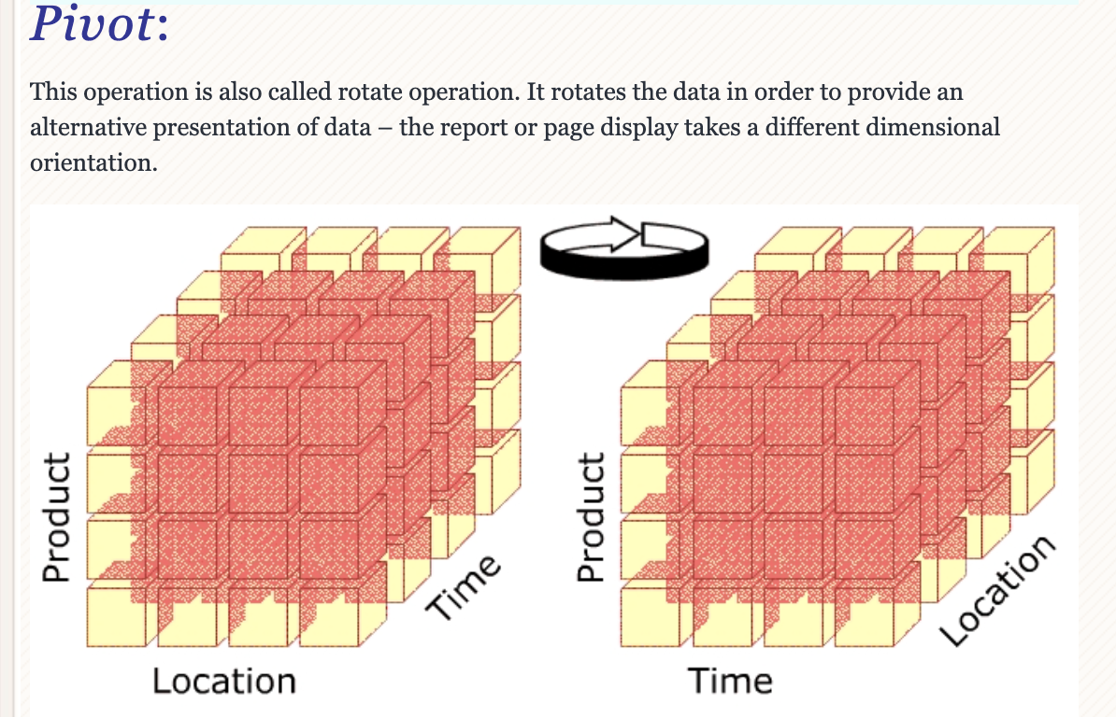
Pivot

Slide 73
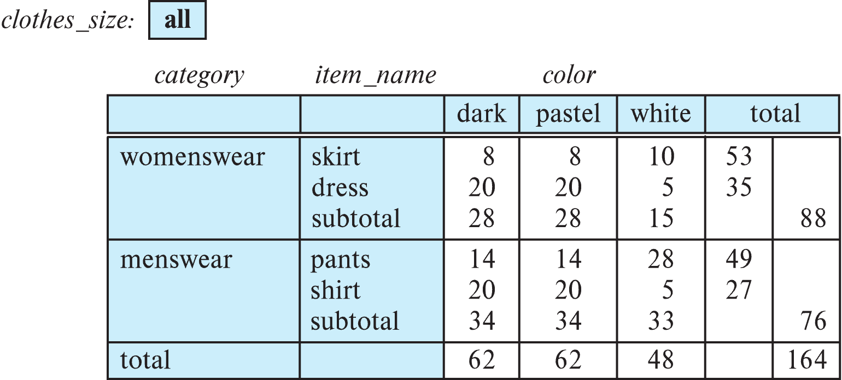
Cross Tabulation With Hierarchy
Cross-tabs can be easily extended to deal with hierarchies
Can drill down or roll up on a hierarchy
E.g. hierarchy: item_name → category

Slide 74
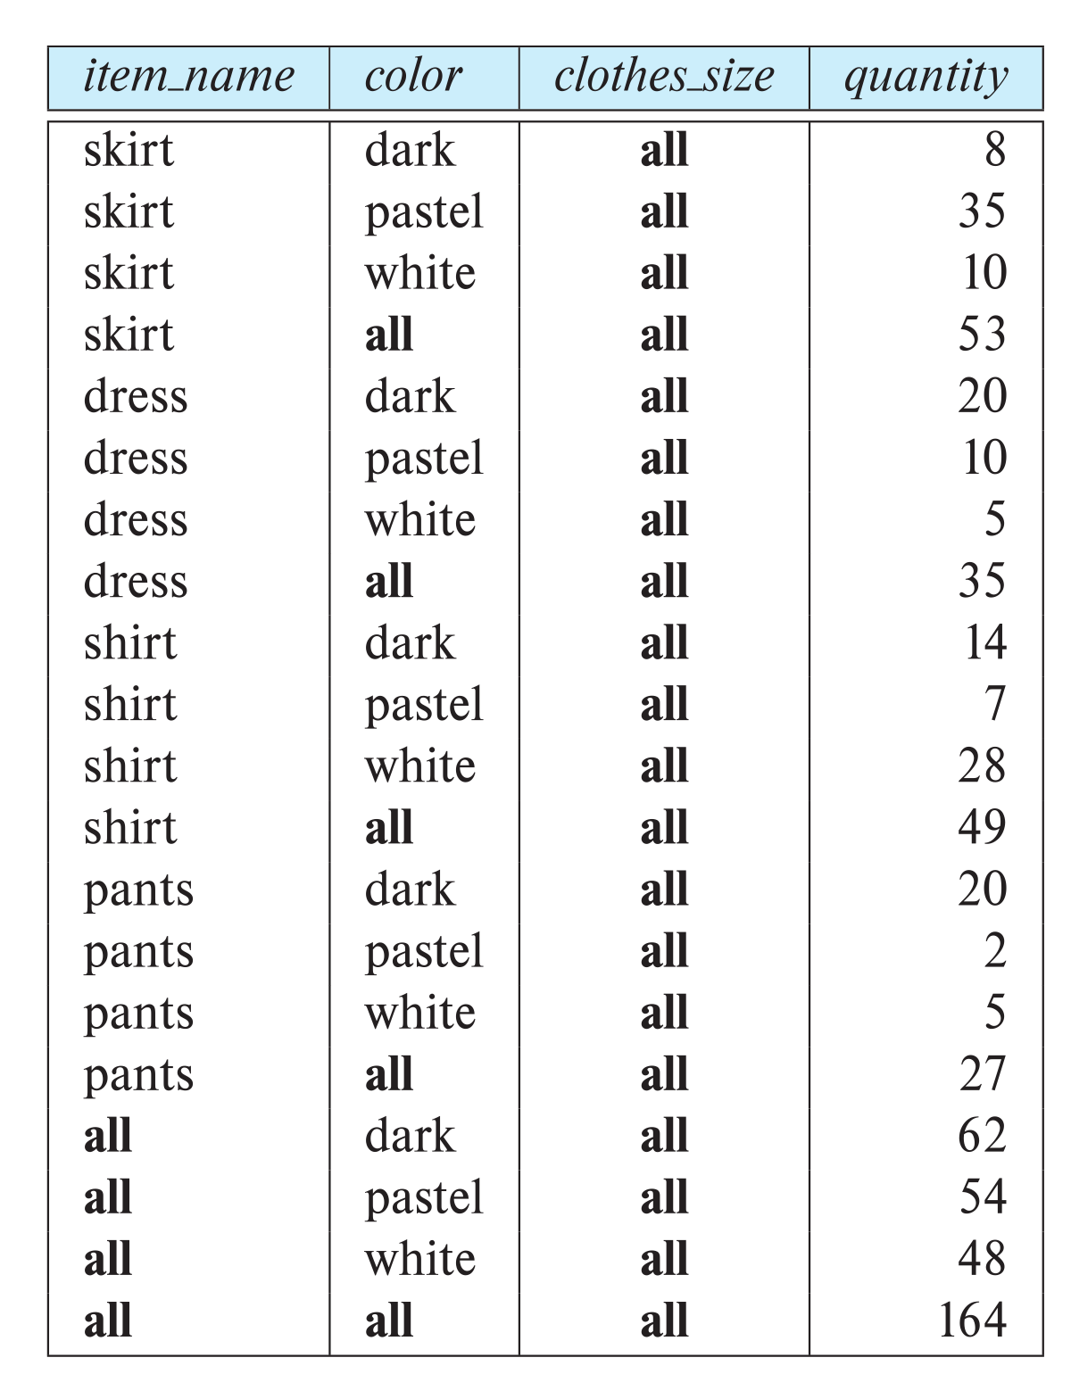
Relational Representation of Cross-tabs
Cross-tabs can be represented as relations
We use the value all to represent aggregates.
The SQL standard actually uses null values in place of all
Works with any data type
But can cause confusion with regular null values.

Slide 75
CAP, BASE
75 | COMS W4111_002_2023_3: Lecture_12_Module_IV © Donald F. Ferguson, 2023

Slide 76
CAP Theorem
Consistency
Every read receives the most recent write or an error.
Availability
Every request receives a (non-error) response – without guarantee that it contains the most recent write.
Partition Tolerance
The system continues to operate despite an arbitrary number of messages being dropped (or delayed) by the network between nodes

Slide 77
Consistency Models
STRONG CONSISTENCY: Strong consistency is a consistency model where all subsequent accesses to a distributed system will always return the updated value after the update.
WEAK CONSISTENCY: It is a consistency model used in distributed computing where subsequent accesses might not always be returning the updated value. There might be inconsistent responses.
EVENTUAL CONSISTENCY: Eventual consistency is a special type of weak consistency method which informally guarantees that, if no new updates are made to a given data item, eventually all accesses to that item will return the last updated value.

Slide 78
BASE
Eventually-consistent services are often classified as providing BASE (Basically Available, Soft state, Eventual consistency) semantics, in contrast to traditional ACID (Atomicity, Consistency, Isolation, Durability) guarantees. Rough definitions of each term in BASE:
Basically Available: basic reading and writing operations are available as much as possible (using all nodes of a database cluster), but without any kind of consistency guarantees (the write may not persist after conflicts are reconciled, the read may not get the latest write)
Soft state: without consistency guarantees, after some amount of time, we only have some probability of knowing the state, since it may not yet have converged
Eventually consistent: If the system is functioning and we wait long enough after any given set of inputs, we will eventually be able to know what the state of the database is, and so any further reads will be consistent with our expectations

Slide 79
Eventual Consistency
Availability and scalability via
Multiple, replicated data stores.
Read goes to “any” replica.
PUT/POST/DELETE
Goes to any replica
Change propagate asynchronously
GET may not see the latest value if the update has not propagated to the replica.
There are several algorithms for conflict resolution
Detect and handle in application.
Clock/change vectors/version numbers
… …
get
put

Slide 80
ACID – BASE (Simplistic Comparison)
(Or other strategy)

Slide 81
Scalability
81 | COMS W4111_002_2023_3: Lecture_12_Module_IV © Donald F. Ferguson, 2023

Slide 82
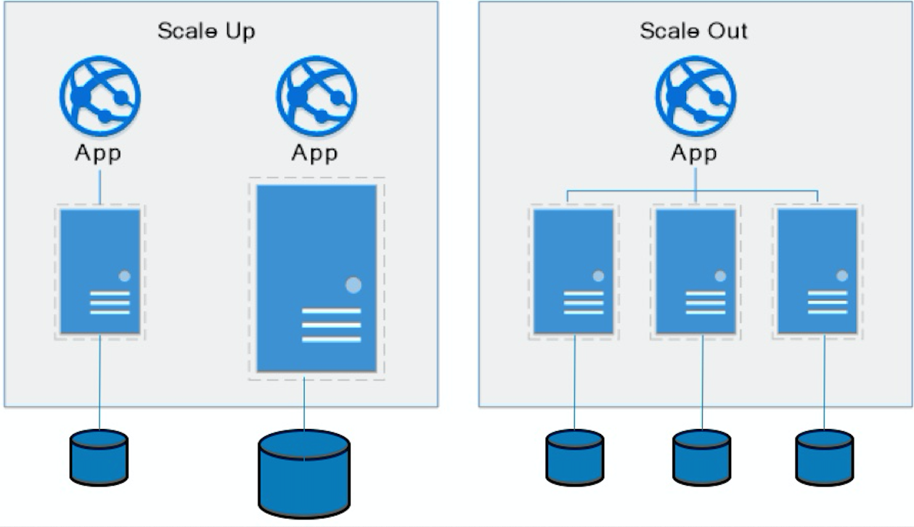
Approaches to Scalability
Scalability is the property of a system to handle a growing amount of work by adding resources to the system.
Scale-up:
Less incremental.
More disruptive.
More expensive for extremely large systems.
Does not improve availability
Scale-out:
Incremental cost.
Data replication enables availability.
Does not work well for functions like JOIN, referential integrity, ... ...
Replace system with a bigger machine, e.g. more memory, CPU, ... ...
Add another system.

Slide 83
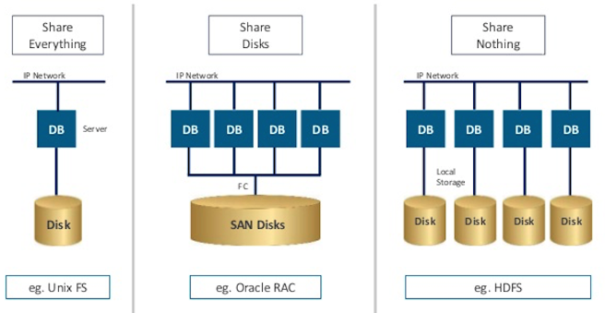
Disk Architecture for Scale-Out
Share disks:
Is basically scale-up for data/disks. You can use NAS, SAN and RAID.
Isolation/Integrity requires distributed locking to control access from multiple database servers.
Share nothing:
Is basically scale-out for disks.
Data is partitioned into shards based on a function f() applied to a key.
Can improve availability, at the code consistency, with data replication.
There is a router that sends requests to the proper shard based on the function.

Slide 84
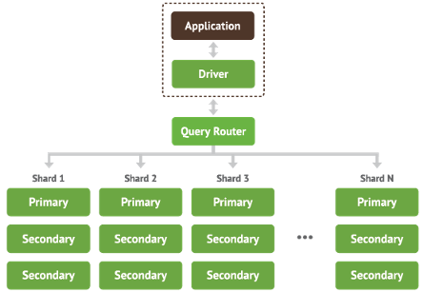
Shared Nothing, Scale-Out
MongoDB Sharding
DynamoDB Partitioning

